Slide 1

Machine Learning Based Chronic Kidney Disease Prediction with a Smart Web Application
Project Guide:
Dr. VIDIVELLI S
Asst.Professor-II-SoC
Sanjai S - 126018042

Slide 2
OBJECTIVE
To identify the most effective feature selection techniques for better diagnosis.
To choose the best classification algorithms for accurate CKD prediction.
An approach to predict Chronic Kidney Disease (CKD) with improved accuracy.
A web-based system ensures quick access to CKD prediction for healthcare providers.

Slide 3
BASE PAPER
Rajib Kumar Halder, Mohammed Nasir Uddin, Md. Ashraf Uddin, Sunil Arya, Sajeeb Saha, Rakib Hossen, Sabbir Ahmed, Mohammad Abu Tareq Rony & Mosammat Farida Akter, “ML-CKDP: Machine learning-based chronic kidney disease prediction with smart web application”, Journal of Pathology Informatics.
Indexed in: Scopus
Year: 2024

Slide 4
PROBLEM STATEMENT
To enhance the accuracy of the existing machine learning model for improved predictive analysis.

Slide 5
LITERATURE REVIEW
YEAR | AUTHORS | TITLE | MODELS | ACCURACY | LIMITATIONS
2021 | Andrew P. Bradley [1] | The use of the area under the ROC curve in the evaluation of machine learning algorithms | KNN | 74.2 % | Results are valid only for the tested configurations.
2021 | Mohammed Nasir Uddin et al.[2] | An ensemble method based multilayer dynamic system to predict cardiovascular disease using machine learning approach. | XGB LR SVM KNN DT | 73.66 % 70.56 % 71.97 % 68.92 % 62.84 % | Very limited number of features were used for the prediction.
2022 | Sibo Prasad Patro et al. [3] | Classification model for heart disease prediction using correlation and feature selection techniques | SVM | 67% | Applying oversampling techniques led to a drop in accuracy
Notes:
1.This makes it unfit for assisting clinicians in the risk for an patient.
2.They used only 11 features which fails to extract the hidden pattern and improve the detection accuracy.

Slide 6
LITERATURE REVIEW
YEAR | AUTHORS | TITLE | MODELS | ACCURACY | LIMITATIONS
2023 | Rahul Sawhney [4] | A comparative assessment of artificial intelligence models used for early prediction and evaluation of chronic kidney disease | SVM | 81 % | Small and highly specific dataset is used
2022 | Ramesh Chandra Poonia et al. [5] | Intelligent Diagnostic Prediction and Classification Models for Detection of Kidney Disease | KNN ANN | 66.25% 65% | Dataset used for training and evaluation contains data from a specific demographic
2022 | Md Mahedi Hassan et al. [6] | An Ensemble Learning Approach for Chronic Kidney Disease Prediction Using Different Machine Learning Algorithms with Correlation Based Feature Selection | KNN SVM | 87.29 % 89.17 % | Correlation method used may not be ideal for non-linear relationships.
Notes:
1.This makes it unfit for assisting clinicians in the risk for an patient.
2.They used only 11 features which fails to extract the hidden pattern and improve the detection accuracy.
3. Mahedi - CBFS(Cubic bipolar fussy sets) may not be ideal for non-linear relationships, as Pearson correlation mainly captures linear dependencies.

Slide 7
LITERATURE REVIEW
YEAR | AUTHORS | TITLE | MODELS | ACCURACY | LIMITATIONS
2022 | Dibaba Adeba Debal et al.[7] | Chronic kidney disease prediction using machine learning techniques | XGB | 82.56% | Traditional machine learning models
2010 | Li-min Wang et al. [8] | Feature Selection and Prediction of Sub-health State Using SVM-RFE | SVM | 80.35% | Uses only one feature selection method
2022 | Pronab Ghosh et al. [9] | Efficient Prediction of Cardiovascular Disease Using Machine Learning Algorithms With Relief and LASSO Feature Selection Techniques | KNN | 83.61 | High level of missing values in the dataset
Notes:
1.This makes it unfit for assisting clinicians in the risk for an patient.
2.They used only 11 features which fails to extract the hidden pattern and improve the detection accuracy.

Slide 8
DATASET
Dataset Overview
Name: Chronic Kidney Disease (CKD) Dataset
Source: UCI Machine Learning Repository
Number of Records: 400
Number of Features: 25 (both numerical and categorical)
Data Types:
Numerical: Age, blood pressure, serum creatinine, sodium, potassium, hemoglobin, etc.
Categorical: Presence of diabetes, hypertension, anemia, etc.
Binary Labels: ckd (chronic kidney disease) or not ckd (no kidney disease).
Data Quality & Integrity
Missing Values: Some features have missing values, especially rbcc and wbcc.
Duplicates: No duplicates in the dataset.
Outliers & Anomalies: Some extreme values in sc (serum creatinine) and bu (blood urea).

Slide 9
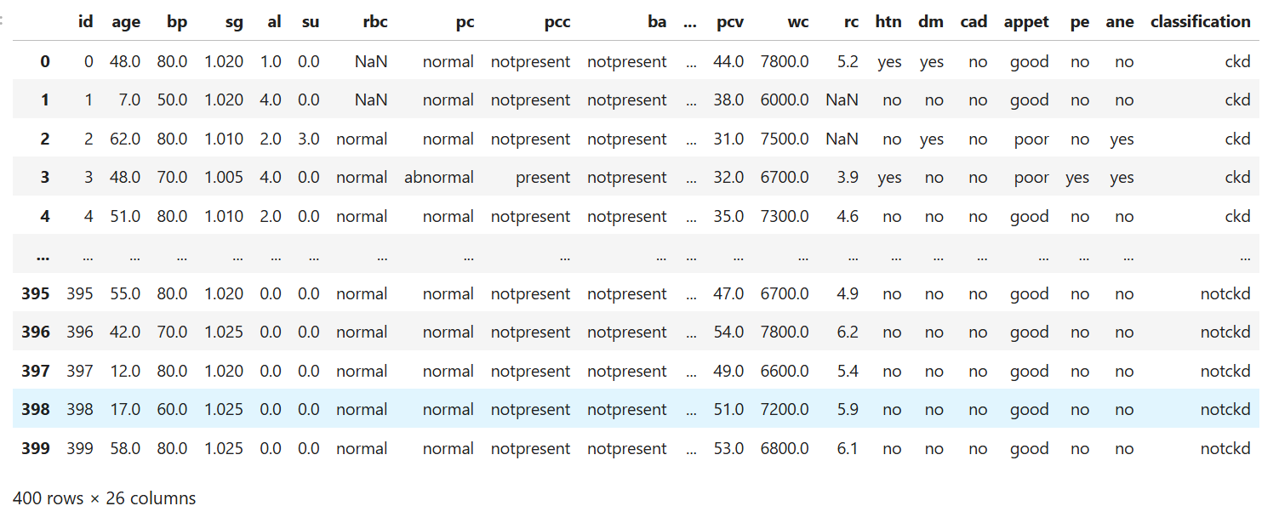
DATASET

Slide 10
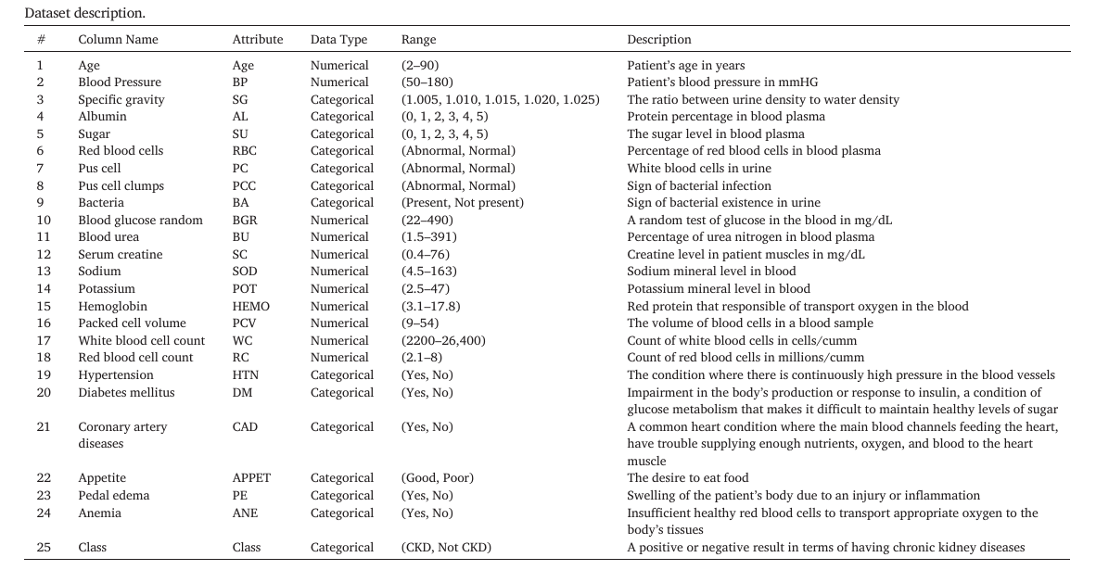
DATASET

Slide 11
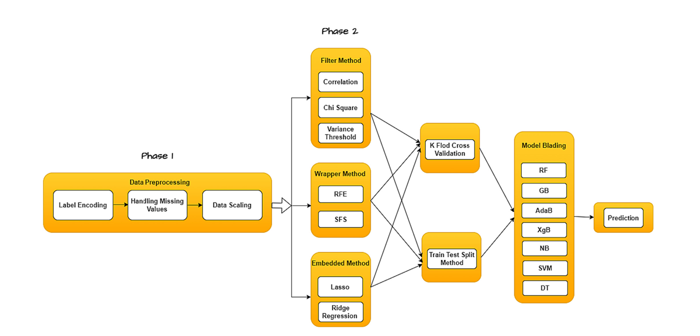
PROPOSED ARCHITECTURE

Slide 12
WORKPLAN
IDEATION
ZERO REVIEW
1ST REVIEW
2ND REVIEW
FINAL REVIEW
Understanding the approach towards the problem
Literature review and a implementable roadmap
Partial implementation of modules sequentially as described in the proposed model
Implementation of the remaining modules and integrating with flask for the prepared models with web frontend

Slide 13
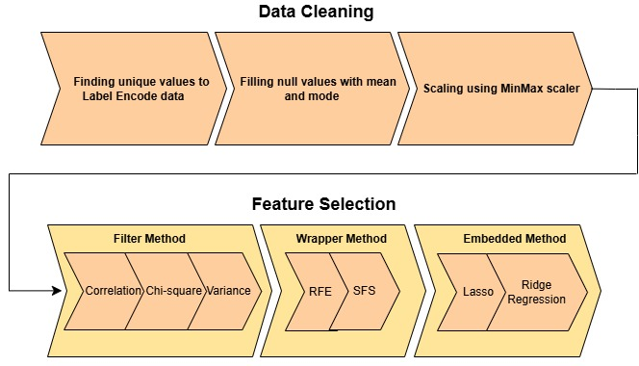

Slide 14
DATA PREPROCESSING
Preprocessing refers to the steps taken to clean, transform, and prepare raw data before feeding it into a machine learning model.
Preprocessing is important because,
It Improves Data Quality
It Enhances Model Performance
It Reduces Computational Complexity
It Ensures Compatibility
It Handles Missing Data

Slide 15
Pre-processing steps consists of:
Data Cleaning
Removing duplicates
Handling missing values
1
Data Transformation
Normalization
Standardization
Encoding categorical variables
2
Data Reduction
Dimensionality reduction
3

Slide 16
Our workflow incorporates preprocessing techniques such as,
Handling missing values:
Missing values are imputed using the mean value to mitigate the impact of data incompleteness.
Normalization:
Min-Max scaling is employed to scale each data point within the range of 0 to 1, ensuring uniformity across numeric features.
Label encoding:
The transformation of categorical variables into numerical representations through label encoding, rendering them suitable for analysis.

Slide 17
FEATURE SELECTION
Selecting a subset of relevant features from the original feature set to reduce the feature space while improving the model’s performance by reducing computational power.

Slide 18
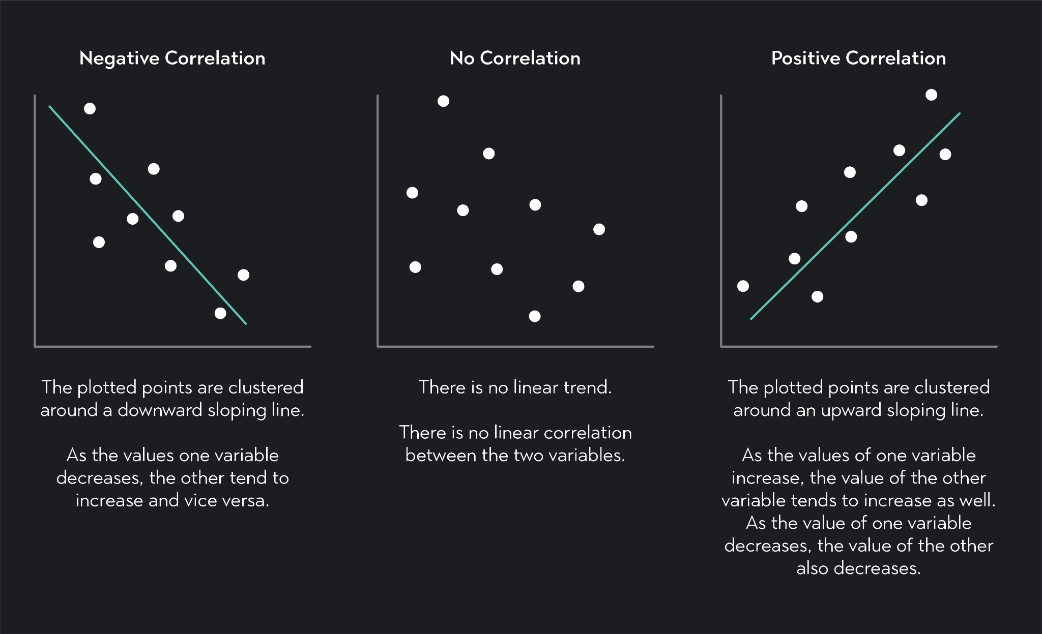
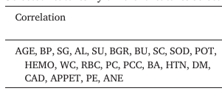
METHOD 1: CORRELATION
The type of correlation used here is Pearson Correlation.
Used to measure how strong a relationship is between two variables.
It yields a value ranging from –1 to 1.
Notes:
Pearson coefficient:
r = n(∑xy) – (∑x)(∑y) / √[n∑x²-(∑x)²][n∑y²-(∑y)²

Slide 19
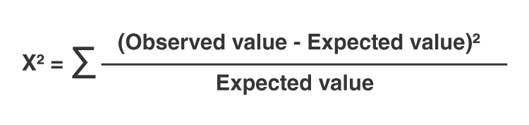
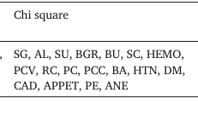
METHOD 2: CHI-SQUARE
It checks whether there’s a significant difference between expected and observed frequencies, guiding us in identifying which features should be included in our model for better predictions.
It is used to determine whether changes in one variable are independent of changes in another.
Notes:
Chi-square:
You've created an instance of SelectFpr, which is a feature selector that filters features to select based on a false positive rate (FPR). The score_func parameter is set to chi2, indicating that you're using the chi-squared test to evaluate the importance of features.
The alpha parameter is set to 0.05, meaning that you're allowing a 5% false positive rate. This means that up to 5% of the features selected might be due to chance rather than actual relevance.

Slide 20
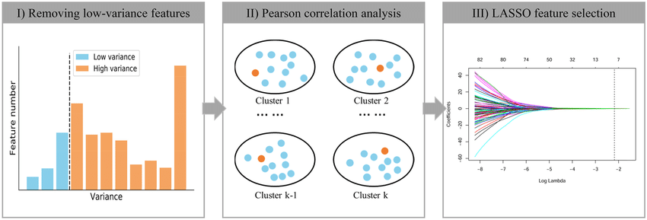
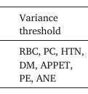
METHOD 3: VARIANCE THRESHOLD
Simple yet effective technique for feature selection that removes features with low variance.
Features with low variance are typically constant or nearly constant throughout the dataset, providing little information for predictive modeling tasks.
Reduces overfitting, improves model performance, enhancing interpretability

Slide 21
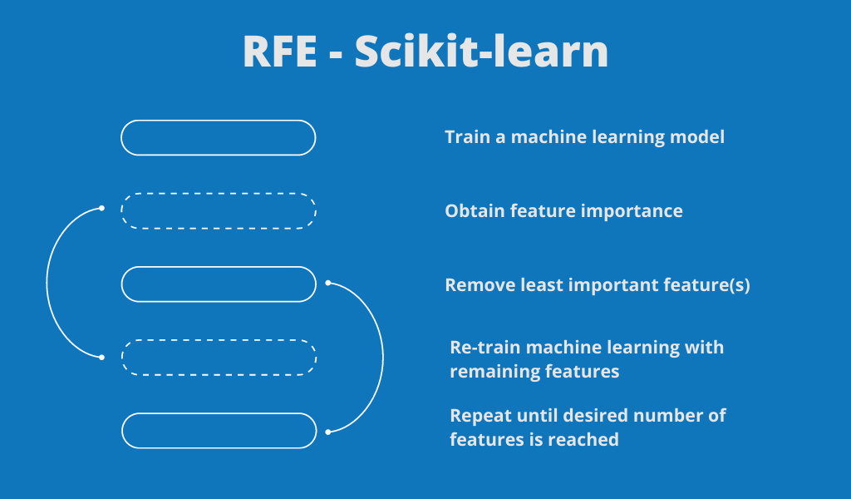
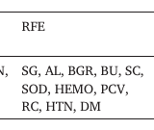
METHOD 4: REPEATED FEATURE SELECTION
Used to select a subset of the most relevant features from a dataset.
It is a recursive process that starts with all the features in the dataset and then iteratively removes the least essential features until the desired number of features is reached.
Logic behind RFE is that the most relevant features will have the highest impact on the target variable, and thus will be more useful for predicting the target.
Notes:
RFE uses a model (such as a linear regression or support vector machine) to evaluate the importance of each feature, and the features with the lowest importance are eliminated in each iteration.

Slide 22
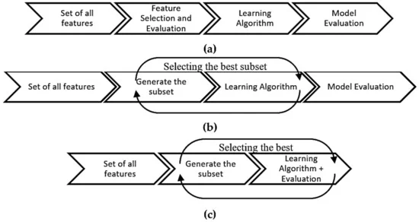
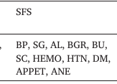
METHOD 5: SEQUENTIAL FEATURE SELECTION
Is a process of identifying and selecting the most relevant features from a dataset for a particular predictive modeling task.
The SequentialFeatureSelector class in scikit-learn works by iteratively adding or removing features from a dataset in order to improve the performance of a predictive model.
In our code we have implemented the forward model till we reach a 11 features threshold.

Slide 23

METHOD 6: LASSO REGRESSION
The name Lasso stands for Least Absolute Shrinkage and Selection Operator.
Lasso was designed to improve the interpretability of machine learning models by reducing the number of features, decisions made by a linear model is better understandable, if they are based on fewer variables.
This feature selection procedure is independent of the performance metric that we are going to use to evaluate the performance of the final model.
Selected features by Lasso Regression:

Slide 24
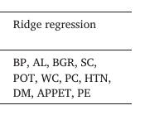
METHOD 7: RIDGE REGRESSION
Ridge regression is used during feature selection to reduce the impact of multicollinearity and prevent overfitting..
Multicollinearity denotes when two or more predictors have a near-linear relationship.
Features with positive coefficients are selected by filtering the array of feature names names based on the condition ridge_coef > 0. This can help in identifying which features are positively contributing to the model's predictions.
Selected features by Ridge Regression:
Notes:
In other words, the model has overfitted on a specific training set and fails to accurately generalize on new test sets. Such a model is considered unstable

Slide 25
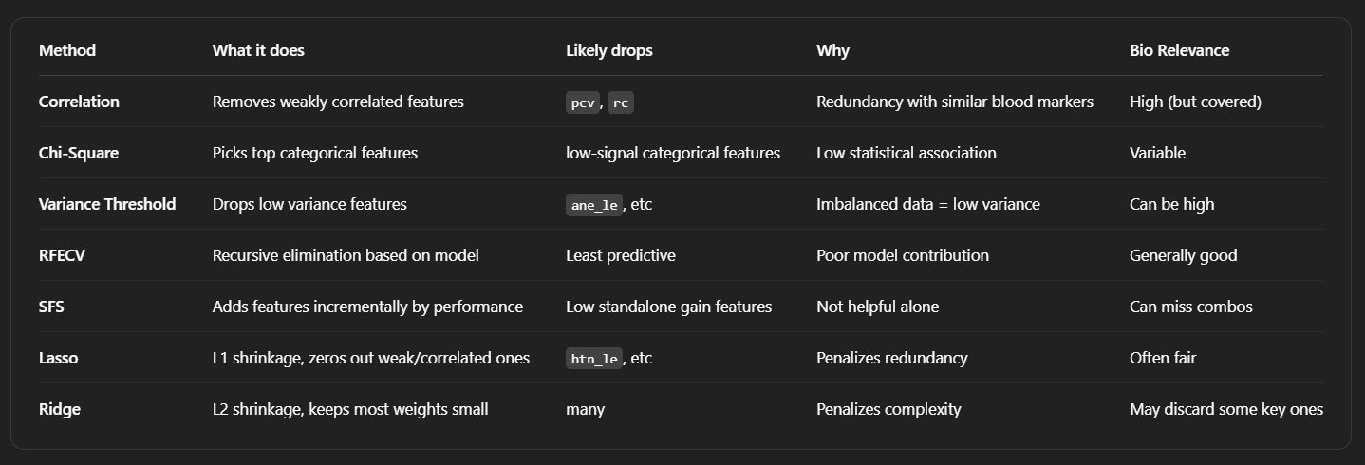
SUMMARY OF SELECTION METHODS
Notes:
In other words, the model has overfitted on a specific training set and fails to accurately generalize on new test sets. Such a model is considered unstable

Slide 26
K FOLD
K-fold cross-validation is a resampling technique used to evaluate machine learning models.
It splits the dataset into k subsets (folds), using k-1 folds for training and 1 fold for testing, rotating through all folds.
This method ensures:
  Better model evaluation by reducing variance.
  Prevention of overfitting compared to a simple train-test split.
The dataset was split using both train-test split and k-fold cross-validation.
K-fold provides a more reliable estimate of model performance across different data distributions.
Applied k = 10, 20, and 30 to compare classifier robustness.

Slide 27
K controls how many times the dataset is split for training and testing.
Generally,
Lower k values (e.g., K=5, K=10) reduce computation but might introduce more variance in accuracy.
Higher k values (e.g., K=20, K=30) improve stability but increase computational cost.
The goal was to observe whether increasing K leads to better performance or just adds computational complexity without significant accuracy improvement.

Slide 28
MODEL BLADING
An ensemble technique that combines predictions from multiple models using a meta-model to improve overall accuracy

Slide 29
CLASSIFIER 1: RANDOM FOREST
Random Forest is an ensemble learning method that constructs multiple decision trees during training and merges their outputs to improve prediction accuracy, stability, and resistance to overfitting compared to a single decision tree.
It selects random subsets of features for each tree, ensuring diversity among trees and making the model more robust.
Random Forest can handle missing values, noisy data, and outliers effectively. It maintains high performance across various types of datasets and is well-suited for both classification and regression tasks in real-world applications.

Slide 30
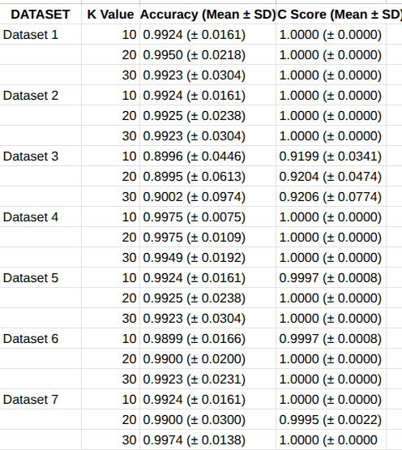
RESULTS FOR RANDOM FOREST

Slide 31
CLASSIFIER 2: GRADIENT BOOSTING
Gradient Boosting builds models sequentially, where each new model corrects the errors of the previous one by minimizing the residual errors.
It uses decision trees as weak learners and optimizes their performance by adjusting weights through gradient descent, making the model more accurate with each step.
Gradient Boosting is highly effective for both classification and regression tasks, as it improves predictions by focusing on errors. However, it can overfit if not properly tuned with regularization techniques.

Slide 32
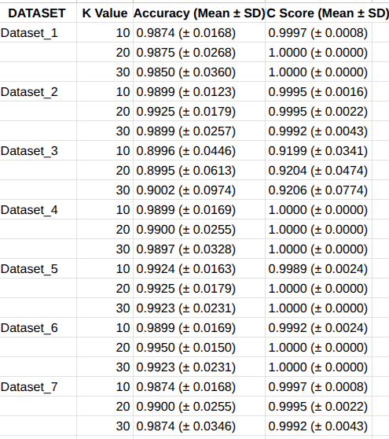
RESULTS FOR GRADIENT BOOSTING

Slide 33
CLASSIFIER 3: ADABOOST (Adaptive Boosting)
Adaptive Boosting is a powerful ensemble learning technique that combines multiple weak classifiers to create a strong classifier. It works by sequentially adding classifiers to correct the errors made by previous models giving more weight to the misclassified data points.
AdaBoost improves by focusing on hard-to-classify cases while Gradient Boosting improves by correcting errors.
Adaptive Boosting is sensitive to noisy data and outliers since it assigns higher weights to misclassified points, which can sometimes lead to overfitting.

Slide 34
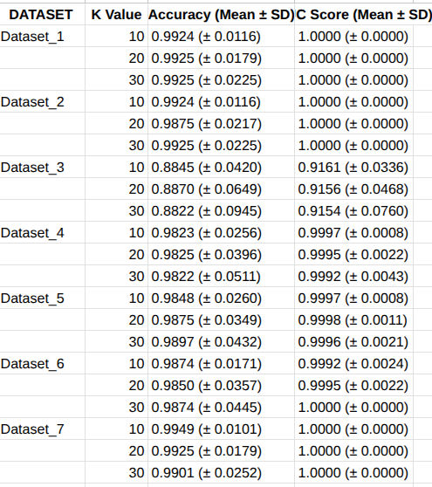
RESULTS FOR ADABOOST

Slide 35
CLASSIFIER 4: XGBOOSTING (eXtreme Gradient Boosting)
XGBoost supports both classification and regression tasks and is widely used in machine learning competitions due to its scalability and superior predictive performance.
XGBoost is an optimized implementation of Gradient Boosting that uses GB to build strong models from weak learners, optimized for speed and performance.
It enhances performance and accuracy through optimized techniques like parallel processing, regularization, and efficient handling of missing values.

Slide 36
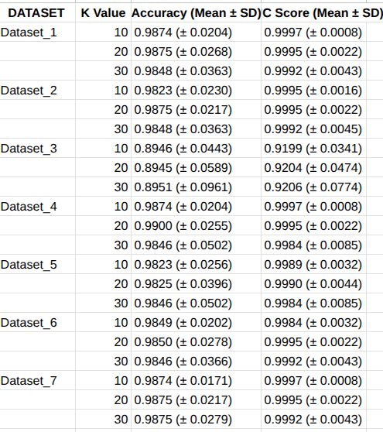
RESULTS FOR XGBOOST

Slide 37
CLASSIFIER 5: SUPPORT VECTOR MACHINE
SVM aims to find the optimal hyperplane that separates the data into two classes with the maximum margin.
Margin refers to the distance between the hyperplane and the nearest data points from each class, known as support vectors.
When the data is linearly separable, SVM finds a straight line (or plane) that divides the classes.For non-linear data, SVM uses kernel tricks (like RBF, polynomial) to transform the data into a higher-dimensional space where a separating hyperplane is possible.

Slide 38
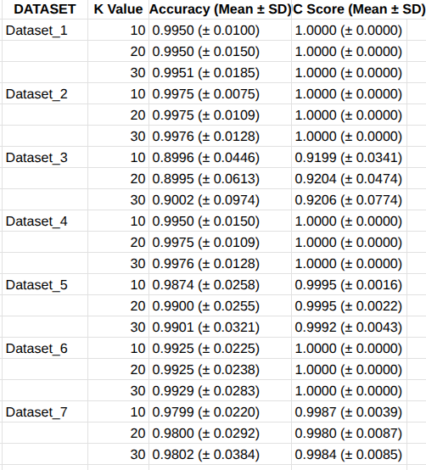
RESULTS FOR SUPPORT VECTOR MACHINE

Slide 39
CLASSIFIER 6: DECISION TREE
A Decision Tree is a tree-structured model that splits the dataset into smaller subsets based on the value of input features.
At each node:
The algorithm chooses the best feature that splits the data to create the most homogeneous child nodes.
The splitting is based on criteria like:
Information Gain (uses Entropy)
Gini Index
This process continues recursively until:
All data points in a node belong to the same class, or
A stopping criterion is reached (e.g., max depth, min samples per node)

Slide 40
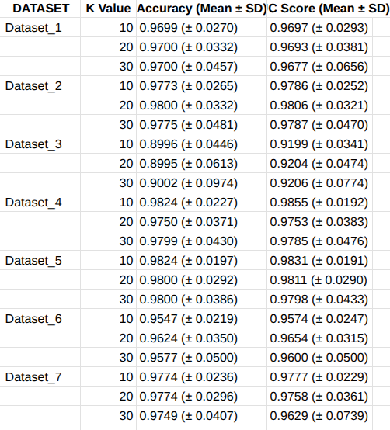
RESULTS FOR DECISION TREE

Slide 41
CLASSIFIER 7: LOGISTIC REGRESSION
Logistic Regression is a supervised learning algorithm which predicts the probability that a data point belongs to a particular class using a logistic (sigmoid) function.
It calculates a linear combination of input features:
z=w1x1+w2x2+⋯+wnxn+bz
Then applies the sigmoid function:
σ(z)=1/1+e^-z
The output is a probability between 0 and 1.
Based on a threshold (usually 0.5), it classifies into one of the two classes.

Slide 42
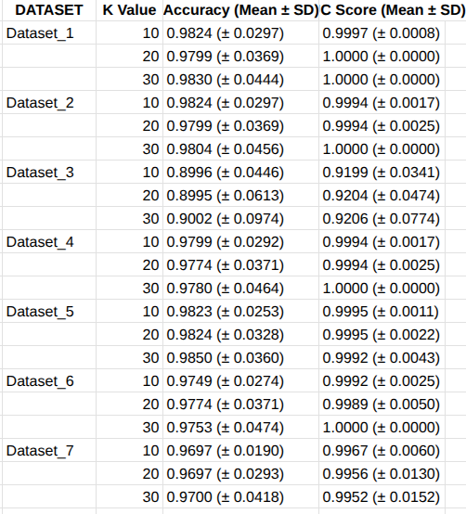
RESULTS FOR LOGISTIC REGRESSION

Slide 43
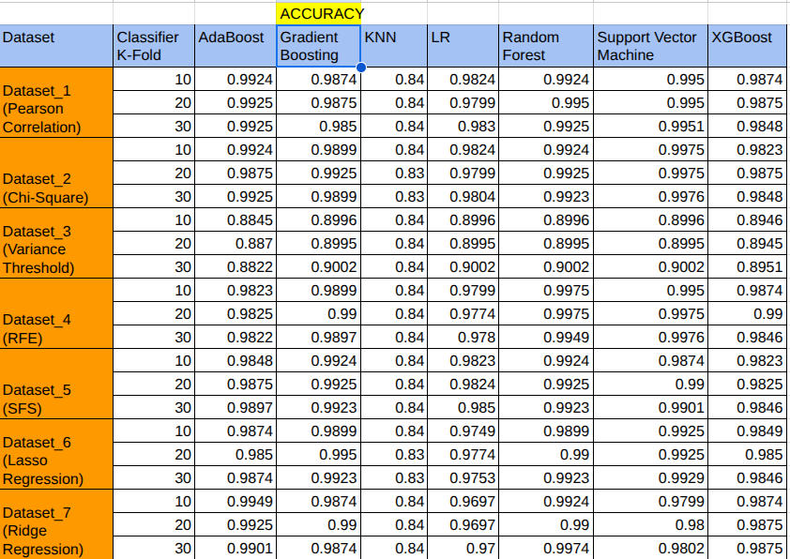
RESULTS FOR K-FOLD (ACCURACY)

Slide 44
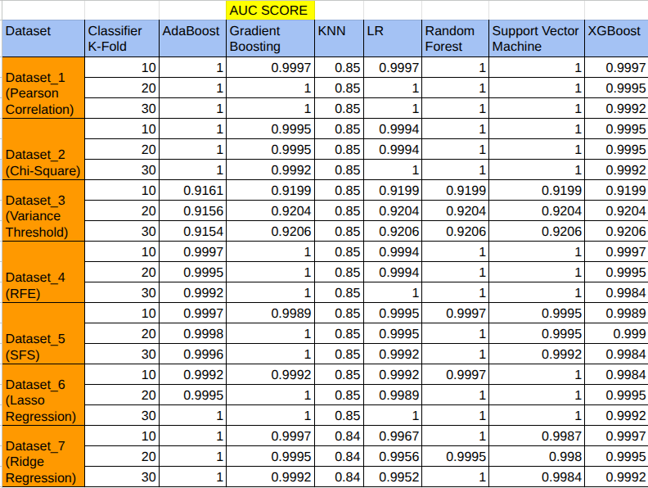
RESULTS FOR K-FOLD (AUC SCORE)

Slide 45
DATASET | PREPROCESSING | FEATURE SELECTION | BEST CLASSIFIER | ACCURACY
DATASET 1 | C | Correlation | AdaBoost, Random Forest | 100%
DATASET 2 | O | Chi square | AdaBoost, Random Forest | 100%
DATASET 3 | M | Variance Threshold | AdaBoost, Gradient Boosting | 95.71%
DATASET 4 | M | RFE | Random Forest | 100%
DATASET 5 | O | SFS | AdaBoost, Random Forest | 100%
DATASET 6 | N | Lasso Regression | AdaBoost, Gradient Boosting | 85.33%
DATASET 7 |  | Ridge Regression | AdaBoost | 99.03%

Slide 46
Web application development
Flask is a lightweight, micro web framework for Python that allows the creation of web applications by providing tools to handle HTTP requests and route them to appropriate functions. It integrates with various databases and machine learning models to process data and generate dynamic content. Flask uses Jinja2 templating for rendering HTML.
The development process involves four program modules:
1.model.pkl
This file stores the trained machine learning model used for predicting CKD and it’s loaded during runtime to make predictions based on user input.
2.app.py
This file contains the Flask application code which handles the backend logic, manage HTTP requests, load the machine learning model, and return the prediction results to the user.

Slide 47
3. index.html:
This is the HTML file for the homepage where users input their medical details. It will likely contain:
A form with various input fields (text boxes, dropdowns).
CSS/Bootstrap styles for the page layout and design.
4. result.html:
This file displays the predicted results based on the user's input.
It will include:
A template to show the prediction result (e.g., "Positive" or "Negative").
A section for displaying the patient's information.

Slide 48
HTML defines the document structure using semantic tags and Bootstrap 5.3.2 classes to create a form-based interface for inputting CKD-relevant clinical parameters.
CSS applies custom styles and media queries to control visual layout, component spacing, form element appearance, and responsiveness across devices.
JavaScript (referenced via functions like main() and myfun()) is intended to handle form submission events and dynamic DOM manipulation, though function definitions are external.
Dataset_1 was selected for model training due to its well-structured and noise-free features, and the Random Forest (RF) classifier was chosen for deployment based on its consistently high accuracy across evaluation metrics.

Slide 49
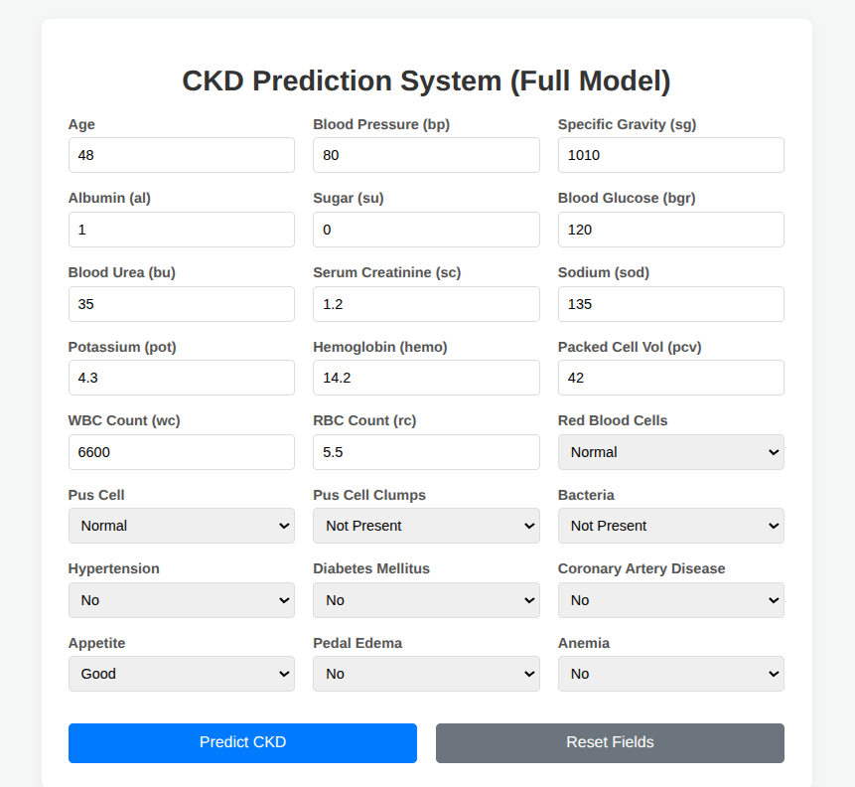
RESULTS:

Slide 50
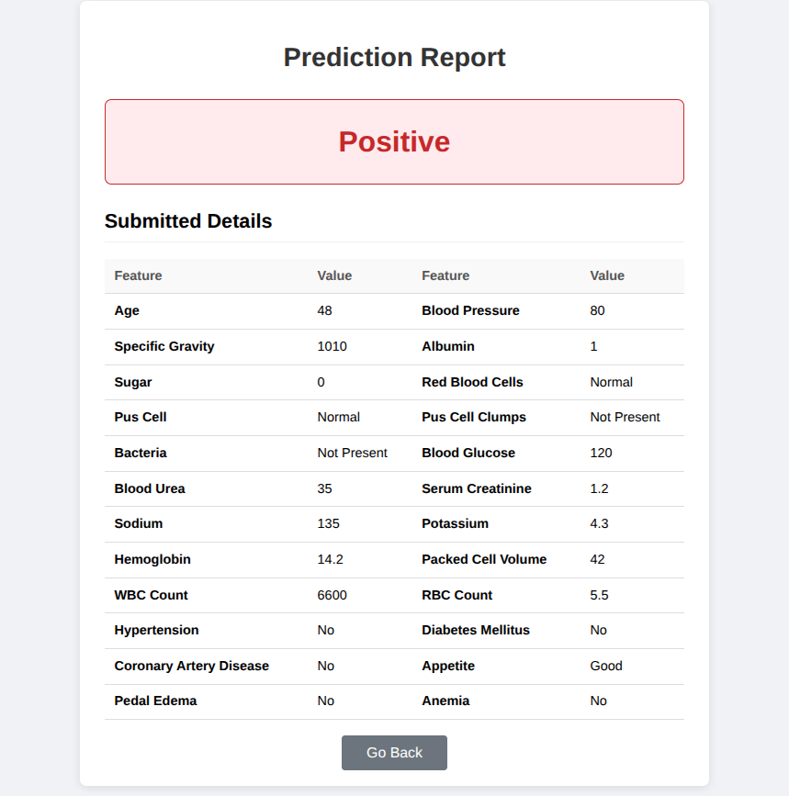
RESULTS:

Slide 51
THANK YOU

